Slide 1
Ch11. Integrated rate laws and reaction mechanisms
Grace 11/19/18

Slide 4
Find Rate Law Expression---Method of Initial Rates
How to determine empirical rate law in lab?
(1) We run several experiments and measure the rate just after the reaction begins (concentrations of each reactant known this way as initial concentrations).
(2) Select a pair of data(2 rows) where only one reactant concentration varies. By comparison, k cancels and we can determine the reaction order of that species. Repeat and find order of each species.
(3) Select any set of data(any row) and plug in the concentration numbers raised to the orders found, we can calculate rate constant k.
(4) Rate law expression found.

Slide 5
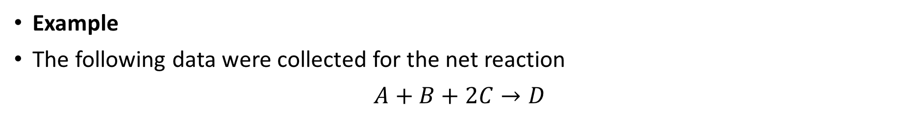
Find Rate Law Expression---Method of Initial Rates
Example
The following data were collected for the net reaction
$A+B+2C→D$
Exp | [A] mol/L | [B] mol/L | [C] mol/L | rate of reaction M/s
1 | 0.01 | 0.01 | 0.1 | 1.2*10³
2 | 0.02 | 0.01 | 0.1 | 4.8*10³
3 | 0.03 | 0.01 | 0.2 | 2.16*10⁴
4 | 0.04 | 0.02 | 0.1 | 3.84*10⁴
What is the rate law for this reaction?
Let us check your answers…

Slide 6

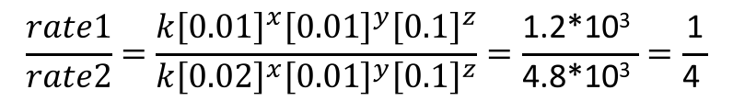
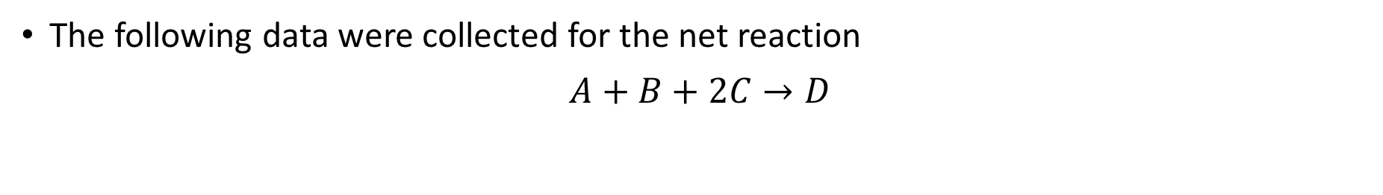
Method of Initial Rates-- Example
The following data were collected for the net reaction
$A+B+2C→D$
Exp | [A] mol/L | [B] mol/L | [C] mol/L | rate of reaction M/s
1 | 0.01 | 0.01 | 0.1 | 1.2*10³
2 | 0.02 | 0.01 | 0.1 | 4.8*10³
3 | 0.03 | 0.01 | 0.2 | 2.16*10⁴
4 | 0.04 | 0.02 | 0.1 | 3.84*10⁴
$$rate=k{\left[A\right]}^{x}{{\left[B\right]}^{y}\left[C\right]}^{z}$$
Find x, y, z, then solve for k.
(1) Find x, compare Exp 1 and 2,
$$\frac{rate1}{rate2}=\frac{k{\left[0.01\right]}^{x}{{\left[0.01\right]}^{y}\left[0.1\right]}^{z}}{k{\left[0.02\right]}^{x}{{\left[0.01\right]}^{y}\left[0.1\right]}^{z}}=\frac{\text{1.2∗10}\text{3} }{\text{4.8∗10}\text{3} }=\frac{\text{1}}{\text{4} }$$
→ x=2

Slide 7
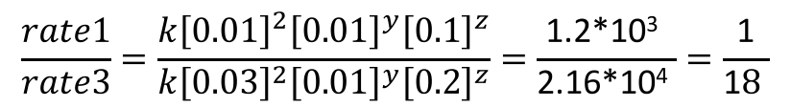
Method of Initial Rates-- Example
The following data were collected for the net reaction
$A+B+2C→D$
Exp | [A] mol/L | [B] mol/L | [C] mol/L | rate of reaction M/s
1 | 0.01 | 0.01 | 0.1 | 1.2*10³
2 | 0.02 | 0.01 | 0.1 | 4.8*10³
3 | 0.03 | 0.01 | 0.2 | 2.16*10⁴
4 | 0.04 | 0.02 | 0.1 | 3.84*10⁴
$$rate=k{\left[A\right]}^{x}{{\left[B\right]}^{y}\left[C\right]}^{z}$$
(2) Find z, compare Exp 1 and 3,
$$\frac{rate1}{rate3}=\frac{k{\left[0.01\right]}^{2}{{\left[0.01\right]}^{y}\left[0.1\right]}^{z}}{k{\left[0.03\right]}^{2}{{\left[0.01\right]}^{y}\left[0.2\right]}^{z}}=\frac{\text{1.2∗10}\text{3} }{\text{2.16}\text{∗10}\text{4} }=\frac{\text{1}}{\text{1}8 }$$
→ z=1

Slide 8
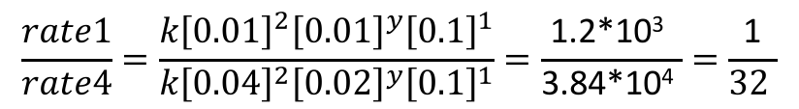
Method of Initial Rates-- Example
The following data were collected for the net reaction
$A+B+2C→D$
Exp | [A] mol/L | [B] mol/L | [C] mol/L | rate of reaction M/s
1 | 0.01 | 0.01 | 0.1 | 1.2*10³
2 | 0.02 | 0.01 | 0.1 | 4.8*10³
3 | 0.03 | 0.01 | 0.2 | 2.16*10⁴
4 | 0.04 | 0.02 | 0.1 | 3.84*10⁴
$$rate=k{\left[A\right]}^{x}{{\left[B\right]}^{y}\left[C\right]}^{z}$$
(3) Find y, compare Exp 1 and 4,
$$\frac{rate1}{rate4}=\frac{k{\left[0.01\right]}^{2}{{\left[0.01\right]}^{y}\left[0.1\right]}^{1}}{k{\left[0.04\right]}^{2}{{\left[0.02\right]}^{y}\left[0.1\right]}^{1}}=\frac{\text{1.2∗10}\text{3} }{\text{3.84}\text{∗10}\text{4} }=\frac{\text{1}}{32 }$$
→ y=1

Slide 9

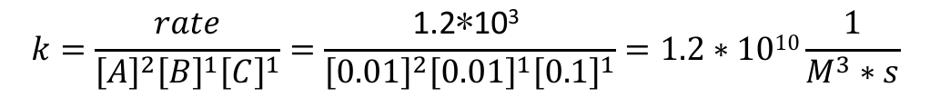

Method of Initial Rates-- Example
The following data were collected for the net reaction
$A+B+2C→D$
Exp | [A] mol/L | [B] mol/L | [C] mol/L | rate of reaction M/s
1 | 0.01 | 0.01 | 0.1 | 1.2*10³
2 | 0.02 | 0.01 | 0.1 | 4.8*10³
3 | 0.03 | 0.01 | 0.2 | 2.16*10⁴
4 | 0.04 | 0.02 | 0.1 | 3.84*10⁴
$$rate=k{\left[A\right]}^{x}{{\left[B\right]}^{y}\left[C\right]}^{z}$$
(3) Find k, use any set of data you like
$$k=\frac{rate}{{\left[A\right]}^{2}{{\left[B\right]}^{1}\left[C\right]}^{1}}=\frac{\text{1.2∗10}\text{3} }{{\left[0.01\right]}^{2}{{\left[0.01\right]}^{1}\left[0.1\right]}^{1}}=1.2∗1010\frac{1}{M^{3}∗s}$$
$$rate=(1.2∗1010){\left[A\right]}^{2}{{\left[B\right]}^{1}\left[C\right]}^{1}$$

Slide 10
The Integrated Rate Laws
Definition: an expression for the concentration of the reactants (or products) as a function of time (Concentration vs. Time).
Please just memorize those:
You can do derivation of those equations if you want, but simply memorizing those is good enough for the test!
Pseudo-First order: when a reaction is 2nd order overall, but concentration of one species is very very high compared to the other, and can be viewed as unchanged(constant) during the reaction.

Slide 11
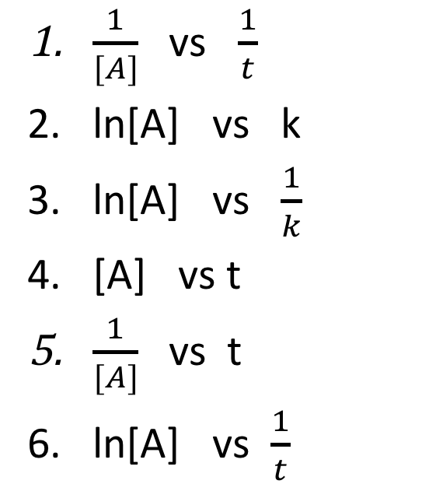
Example:
A reaction A→ products is observed to obey second- order kinetics. Which of the following choices would give a straight line plot where the slope equals the rate constant?
$\frac{1}{[A]}$ vs $\frac{1}{t}$
ln[A] vs k
ln[A] vs $\frac{1}{k}$
[A] vs t
$\frac{1}{[A]}$ vs t
ln[A] vs $\frac{1}{t}$
Key: #5

Slide 12
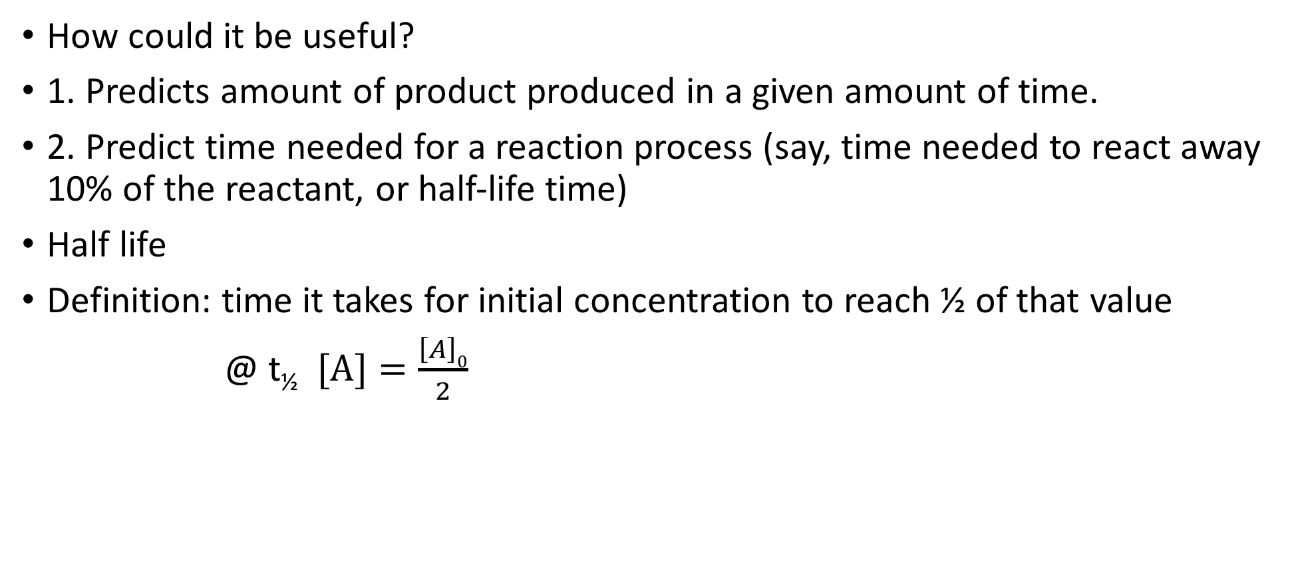
The Integrated Rate Laws
How could it be useful?
1. Predicts amount of product produced in a given amount of time.
2. Predict time needed for a reaction process (say, time needed to react away 10% of the reactant, or half-life time)
Half life
Definition: time it takes for initial concentration to reach ½ of that value
@ t_{½} $[A]=\frac{\left[A\right]0}{2}$

Slide 13
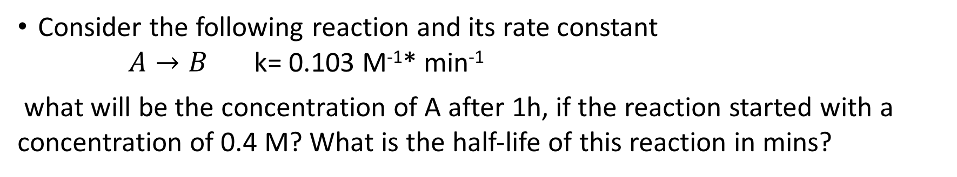
Example:
Consider the following reaction and its rate constant
$A→B$ k= 0.103 M⁻¹* min⁻¹
what will be the concentration of A after 1h, if the reaction started with a concentration of 0.4 M? What is the half-life of this reaction in mins?
Explanation: We need relationship between concentration and time, which is the integrated rate law.
But which one to use? We need to know the reaction order.
How could we know that? By looking at the unit of the rate constant k given!
M⁻¹* min⁻¹ → overall reaction order: second order

Slide 14
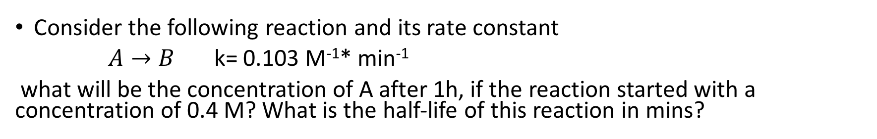
Example:
Consider the following reaction and its rate constant
$A→B$ k= 0.103 M⁻¹* min⁻¹
what will be the concentration of A after 1h, if the reaction started with a concentration of 0.4 M? What is the half-life of this reaction in mins?

Slide 15
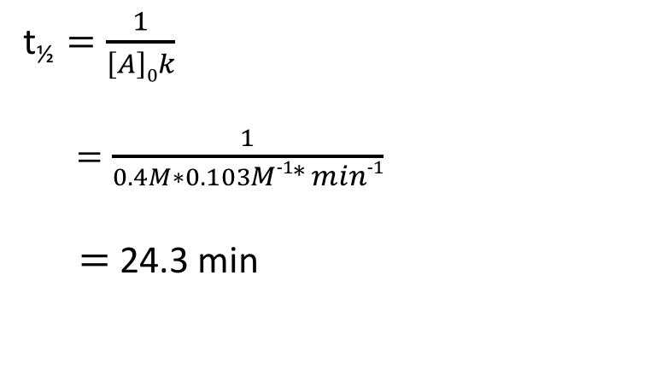
Example:
Consider the following reaction and its rate constant
$A→B$ k= 0.103 M⁻¹* min⁻¹
what will be the concentration of A after 1h, if the reaction started with a concentration of 0.4 M? What is the half-life of this reaction in mins?
Half-life:
Second order:
t_{½} $=\frac{1}{\left[A\right]0k}$
$=\frac{1}{0.4M∗0.103M−1∗ min−1}$
$=$ 24.3 min

Slide 16
Reaction Mechanisms
Definition:
The elementary steps involved in a chemical reaction make up what we call a mechanism.
Net overall reaction= sum of elementary steps
Check validity of your mechanism:
The mechanism we propose will yield an overall rate law, and it must be consistant with the experimental rate law for this mechanism to be valid. (even agrees, the mechanism not necessarily correct, further evidence needed.)

Slide 17
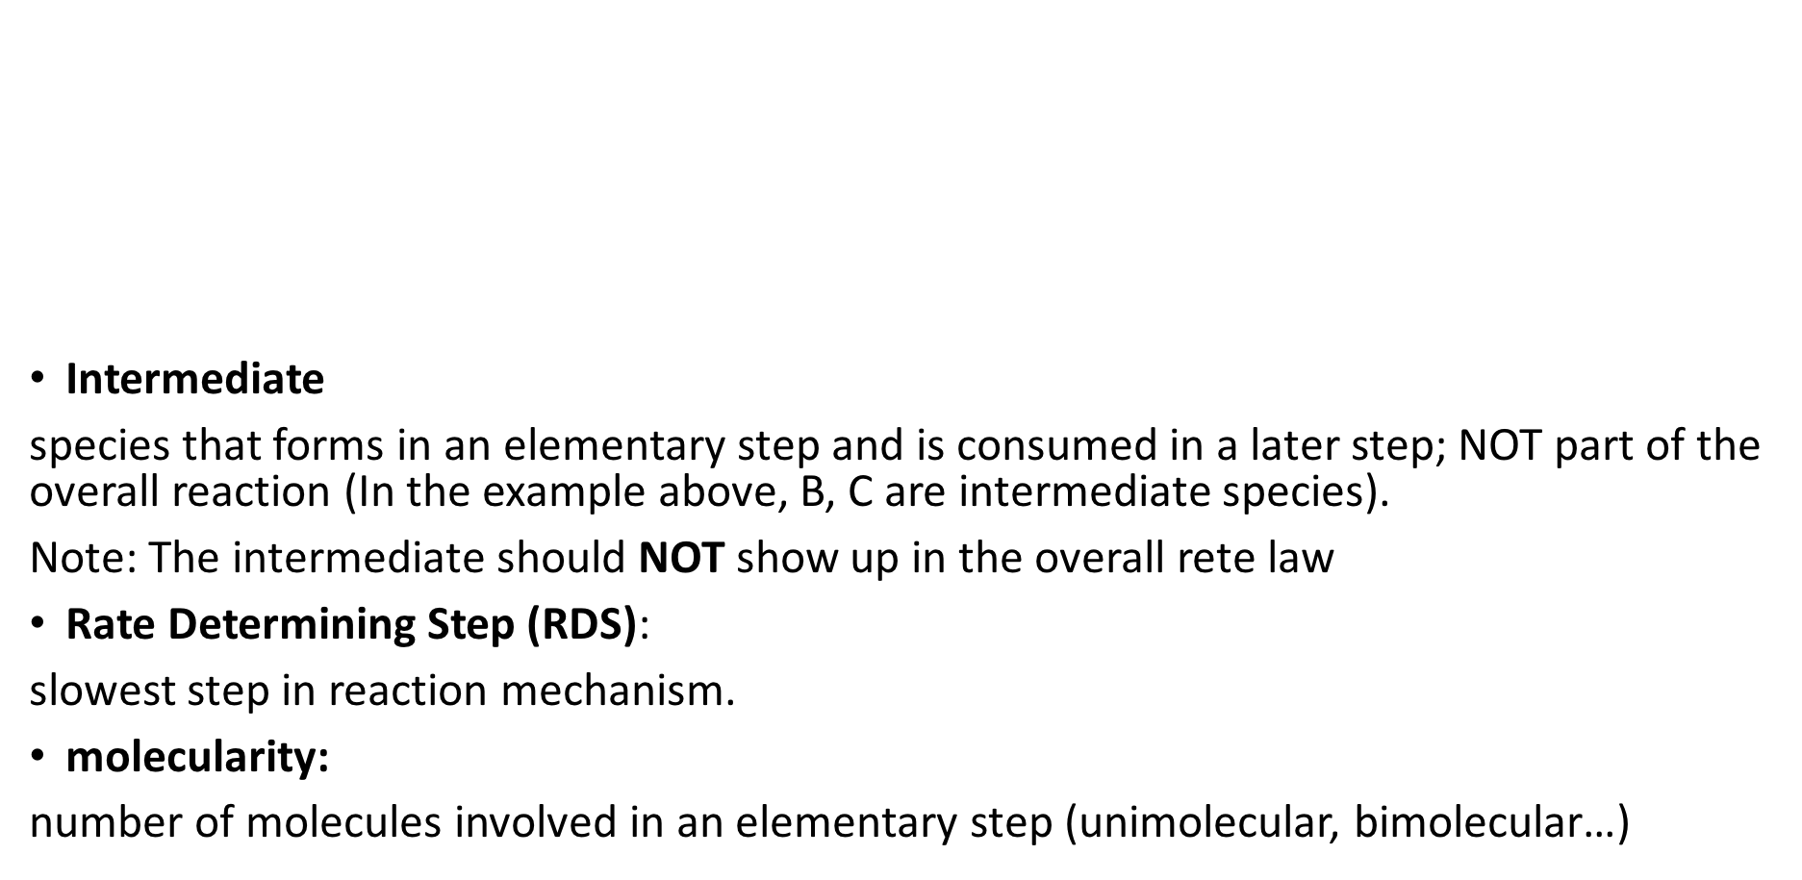
Definitions
Intermediate
species that forms in an elementary step and is consumed in a later step; NOT part of the overall reaction (In the example above, B, C are intermediate species).
Note: The intermediate should NOT show up in the overall rete law
Rate Determining Step (RDS):
slowest step in reaction mechanism.
molecularity:
number of molecules involved in an elementary step (unimolecular, bimolecular…)

Slide 18
Elementary steps
Important: For elementary steps, the rate law could be determined from their chemical equation as written. Unimolecular steps are first order; bimolecular steps are 2nd order overall.
Why: elementary steps in a mechanism are a direct description of how the chemistry is happening.
Note: could NOT write an overall reaction rate law by simply looking at the overall equation!

Slide 19
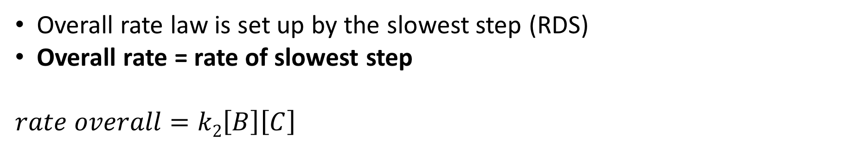
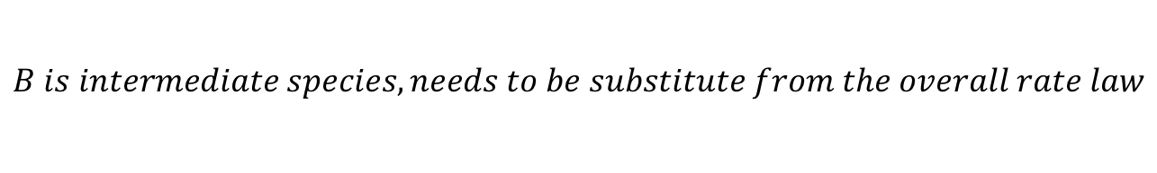
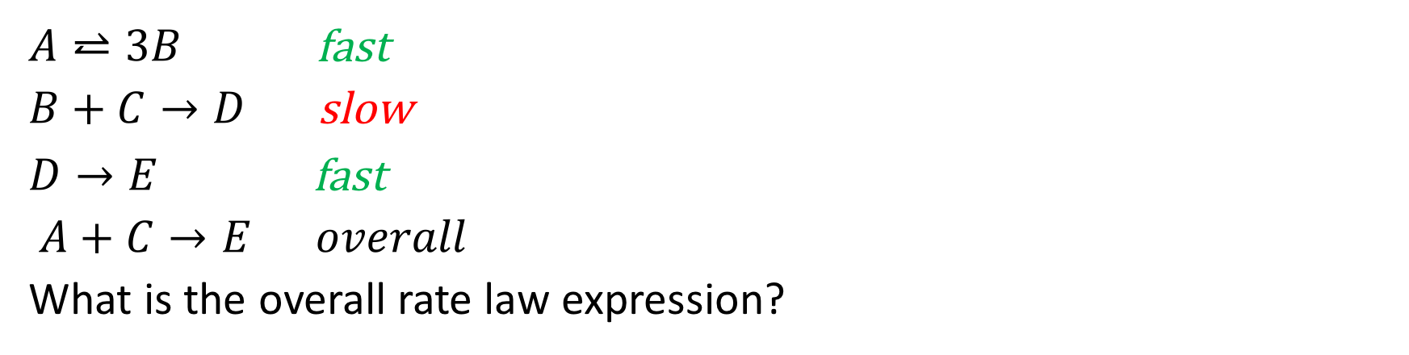
Example
k₁
$A⥨3B$fast
$B+C→D$ slow
$D→E$ fast
$A+C→E overall$
What is the overall rate law expression?
k₋₁
k₂
Elementary steps
k₃
Overall rate law is set up by the slowest step (RDS)
Overall rate = rate of slowest step
$$rate overall=k2\left[B\right]\left[C\right]$$
$$B is intermediate species, needs to be substitute from the overall rate law$$

Slide 20
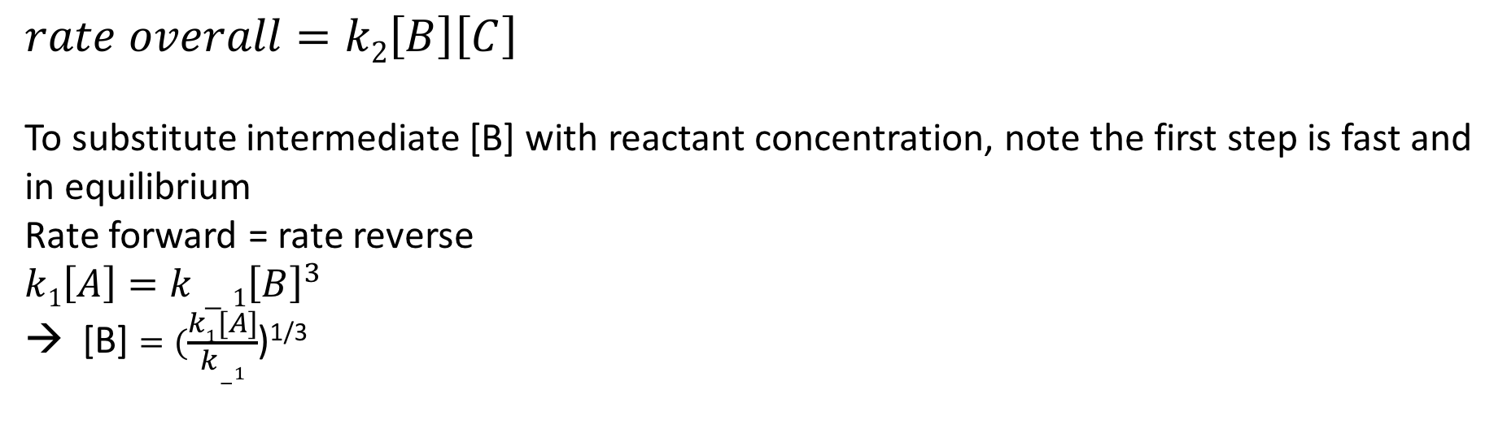
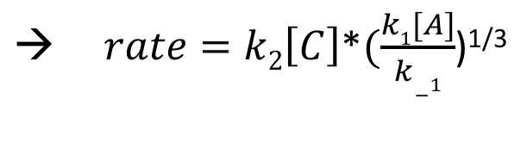
Example
k₁
$A⥨3B$fast
$B+C→D$ slow
$D→E$ fast
$A+C→E overall$
What is the overall rate law expression?
k₋₁
k₂
k₃
$$rate overall=k2\left[B\right]\left[C\right]$$
To substitute intermediate [B] with reactant concentration, note the first step is fast and in equilibrium
Rate forward = rate reverse
$$k1\left[A\right]=k−1{\left[B\right]}^{3}$$
→ [B] $=(\frac{k1[A]}{k−1}$)^{1/3}
$\text{→} rate=k2\left[C\right]$*$(\frac{k1[A]}{k−1}$)^{1/3}

